Slide 1
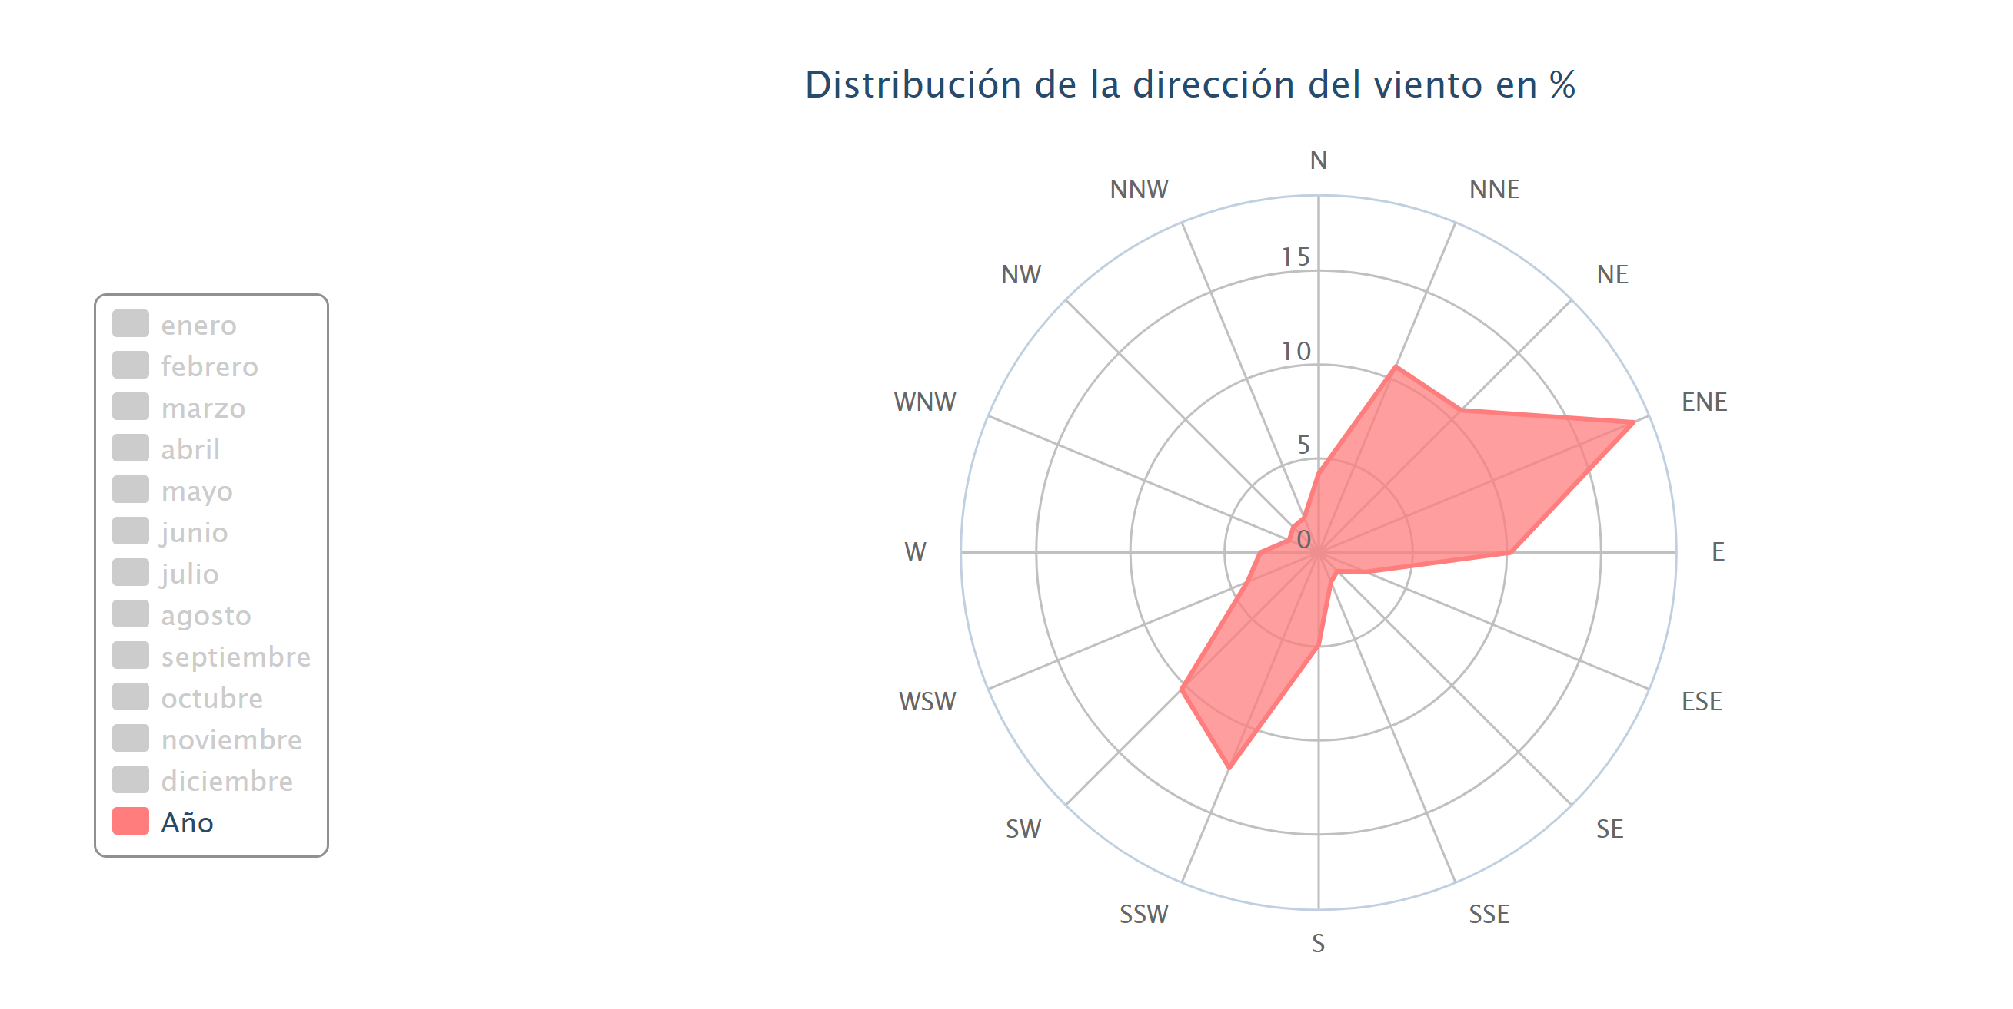
https://es.windfinder.com/windstatistics/gijon_musel

Slide 2
https://www.researchgate.net/publication/269377468_Time_series_analysis_and_forecasting_for_air_pollution_in_small_urban_area_An_SARIMA_and_factor_analysis_approach
Time series analysis and forecasting for air pollution in small urban area: An SARIMA and factor analysis approach
Kaggle project Madrid
https://www.kaggle.com/dhimananubhav/forecasting-ozone-levels-in-madrid?scriptVersionId=5460139
aipred: A Flexible R Package Implementing Methods for Predicting Air Pollution
https://arxiv.org/abs/1805.11534
Indice caqui
https://www.airqualitynow.eu/es/about_indices_definition.php

Slide 3
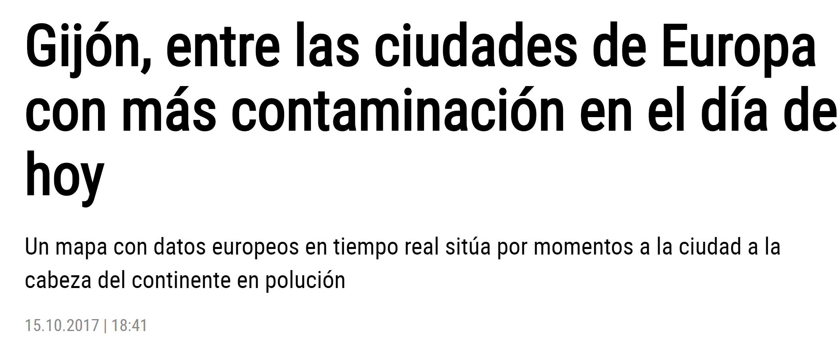
Noticias prensa contaminacion Gijon
https://www.lne.es/gijon/2017/10/15/gijon-ciudades-europa-contaminacion-dia/2178227.html

Slide 4
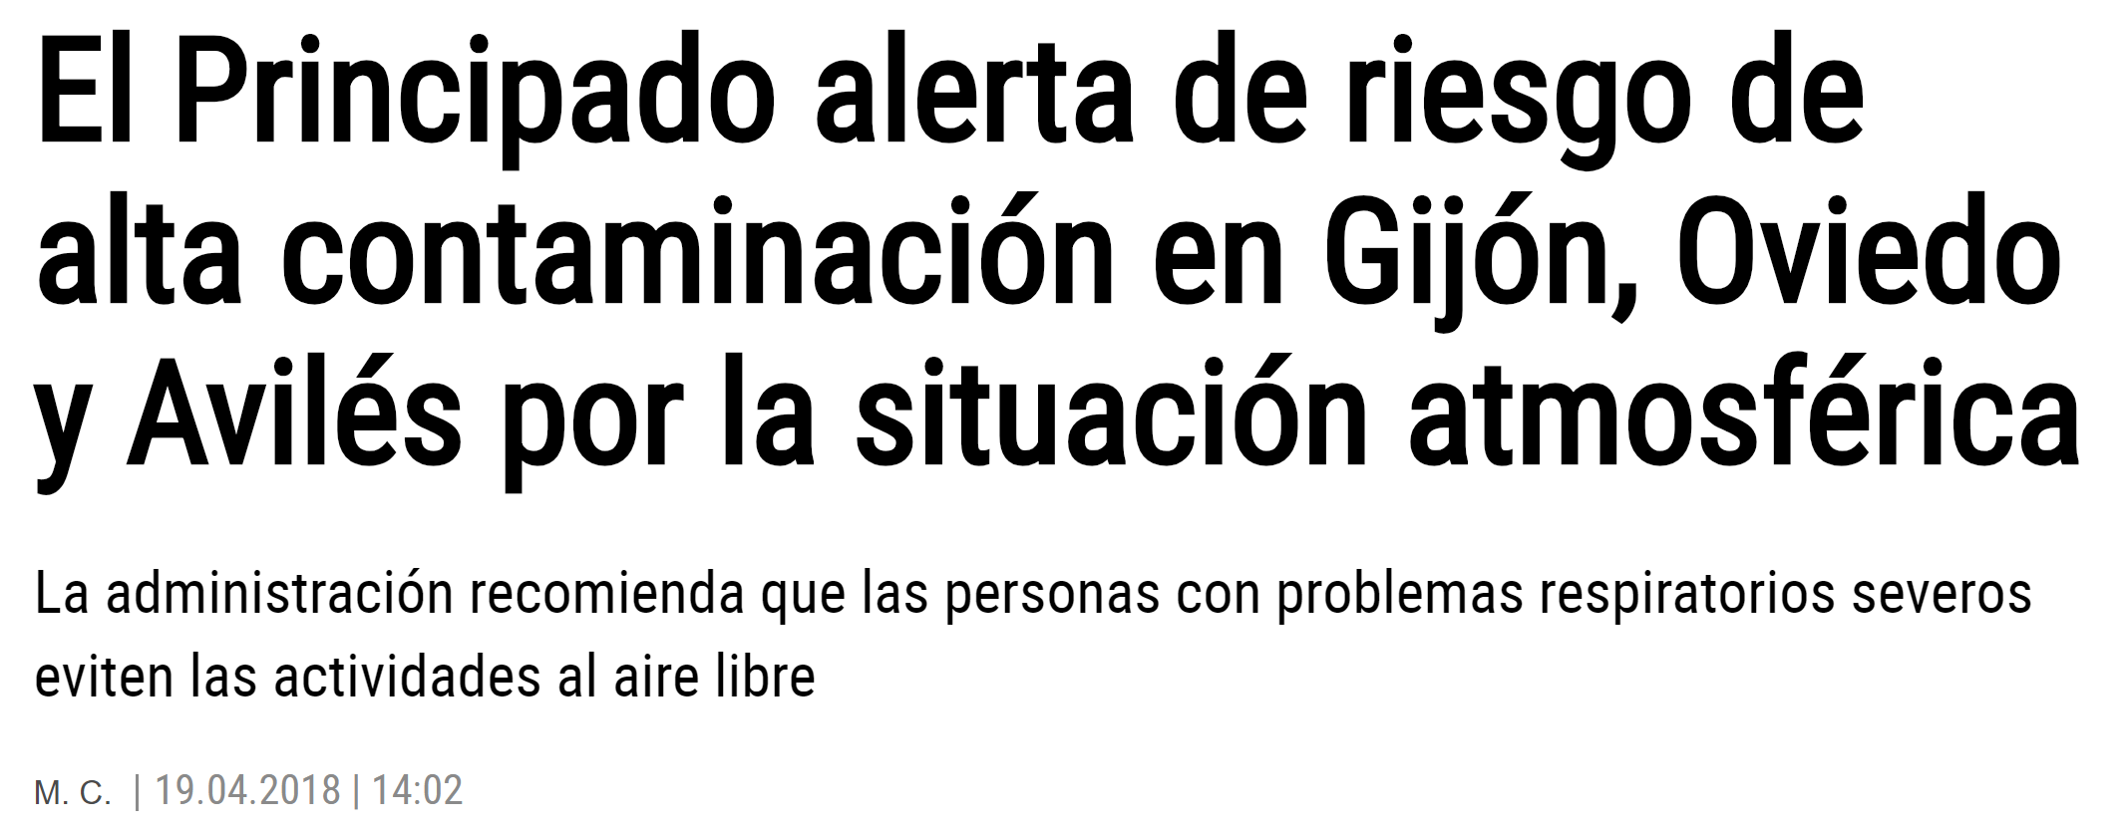
https://www.lne.es/gijon/2018/04/19/principado-alerta-riesgo-alta-contaminacion/2272387.html

Slide 5
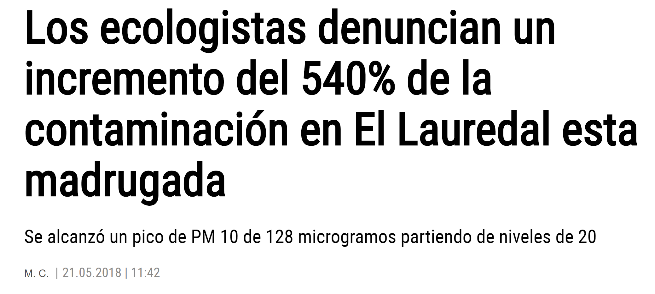
https://www.lne.es/gijon/2018/05/21/ecologistas-denuncian-incremento-540-contaminacion/2290070.html

Slide 6
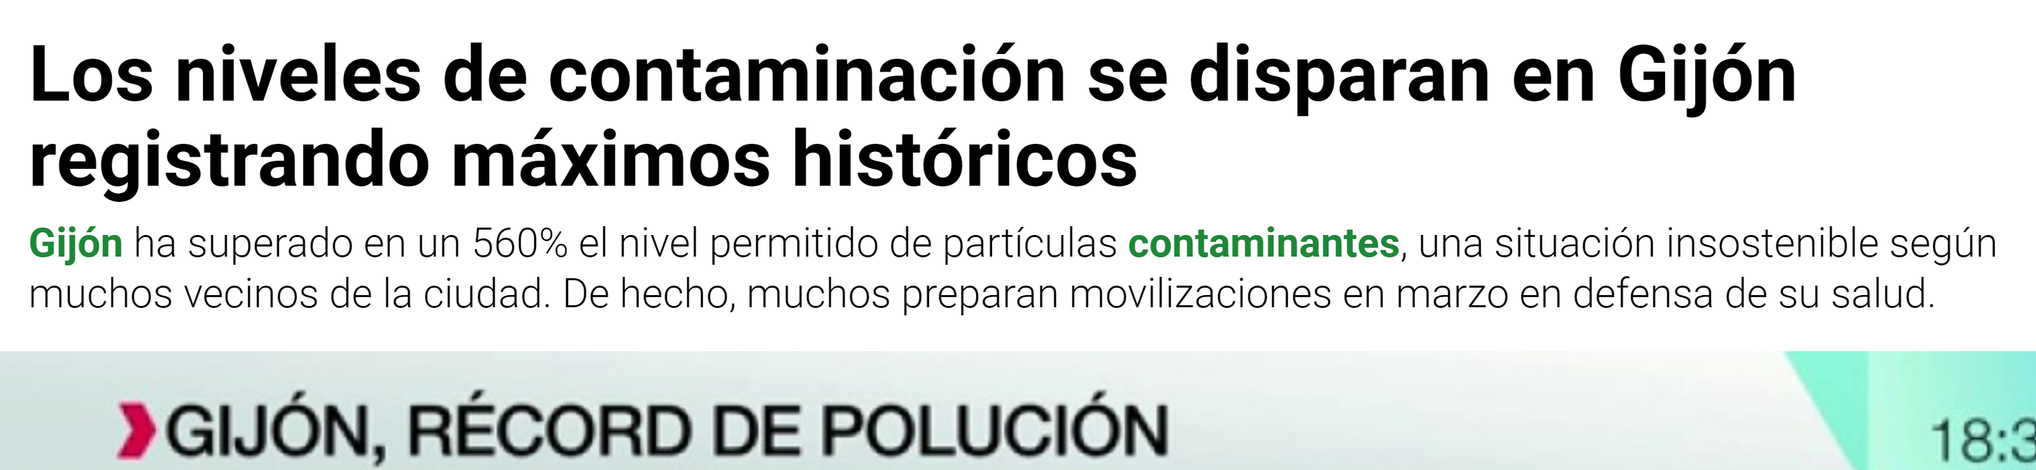
https://www.lasexta.com/programas/mas-vale-tarde/noticias/los-niveles-de-contaminacion-se-disparan-en-gijon-registrando-maximos-historicos_201801185a60de140cf22d7f92e7e0bd.html

Slide 7
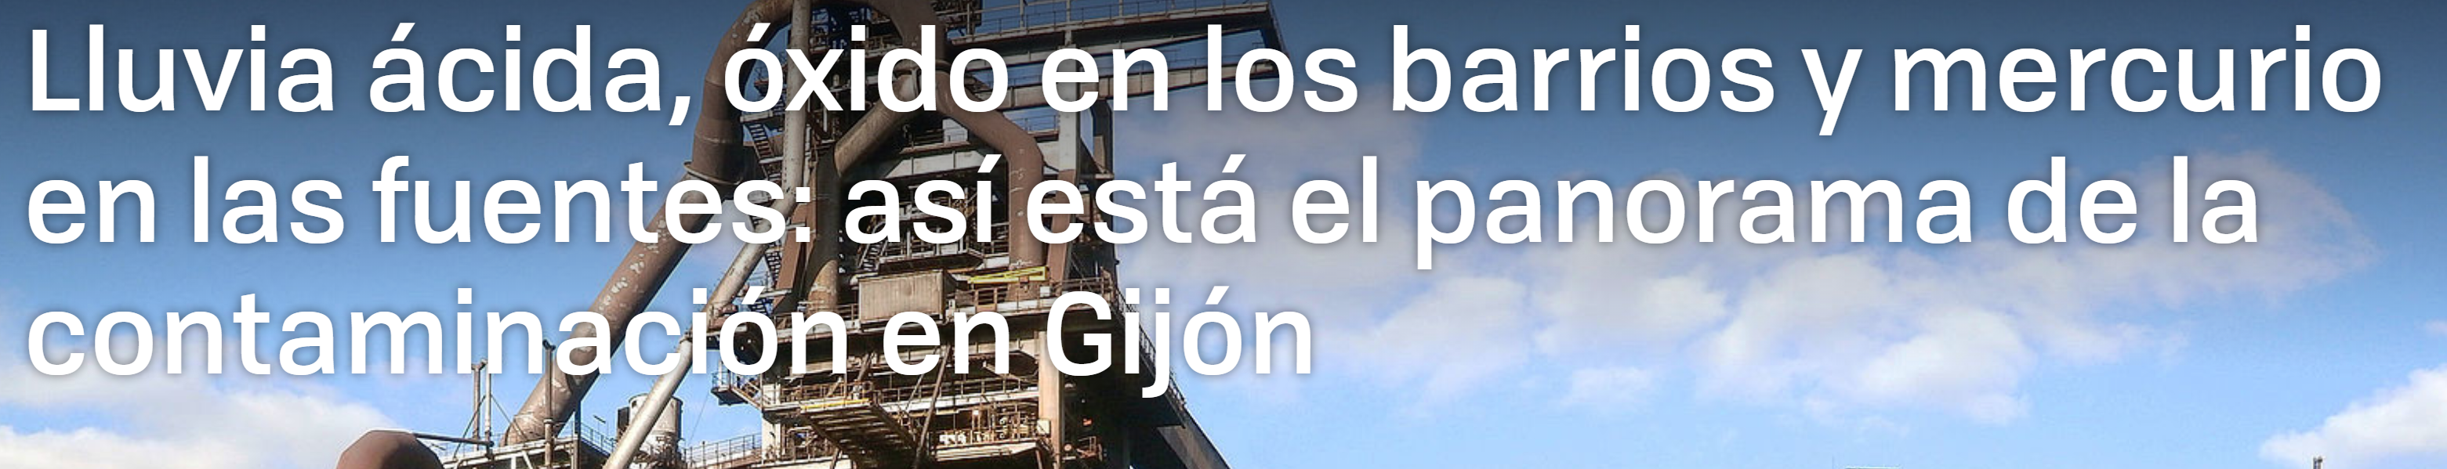
https://www.xataka.com/medicina-y-salud/lluvia-acida-oxido-barrios-mercurio-fuentes-asi-esta-panorama-contaminacion-gijon

Slide 8
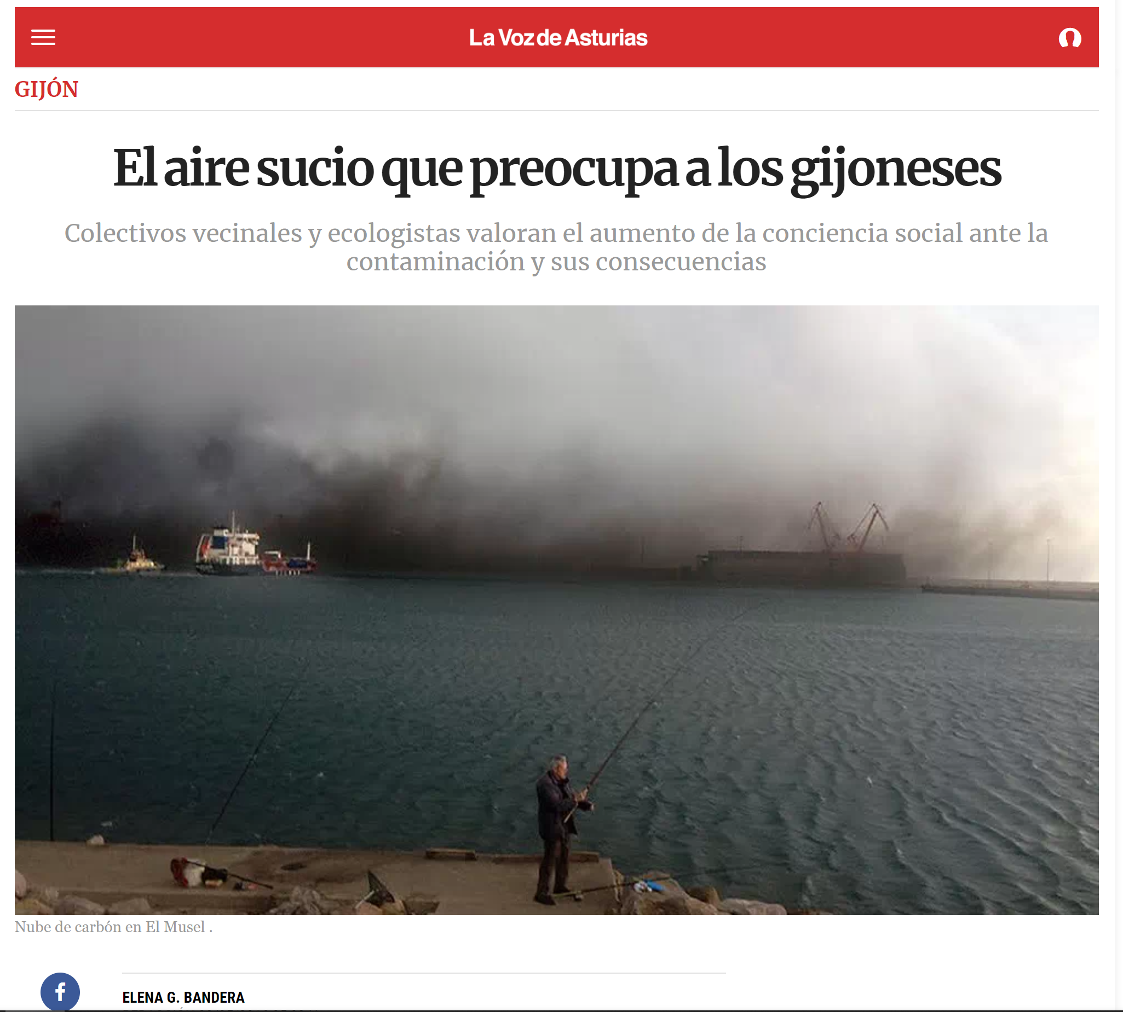
https://www.lavozdeasturias.es/noticia/gijon/2016/05/19/aire-sucio-preocupa-gijoneses/00031463687592274980953.htm

Slide 9
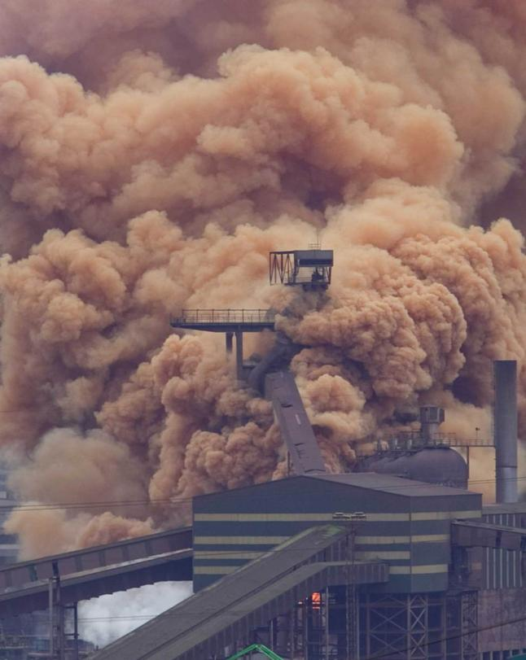
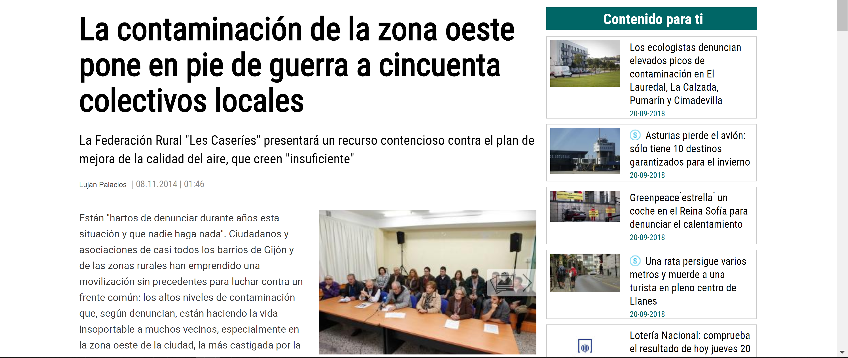
https://www.lne.es/gijon/2014/11/08/contaminacion-zona-oeste-pone-pie/1668252.html

Slide 10
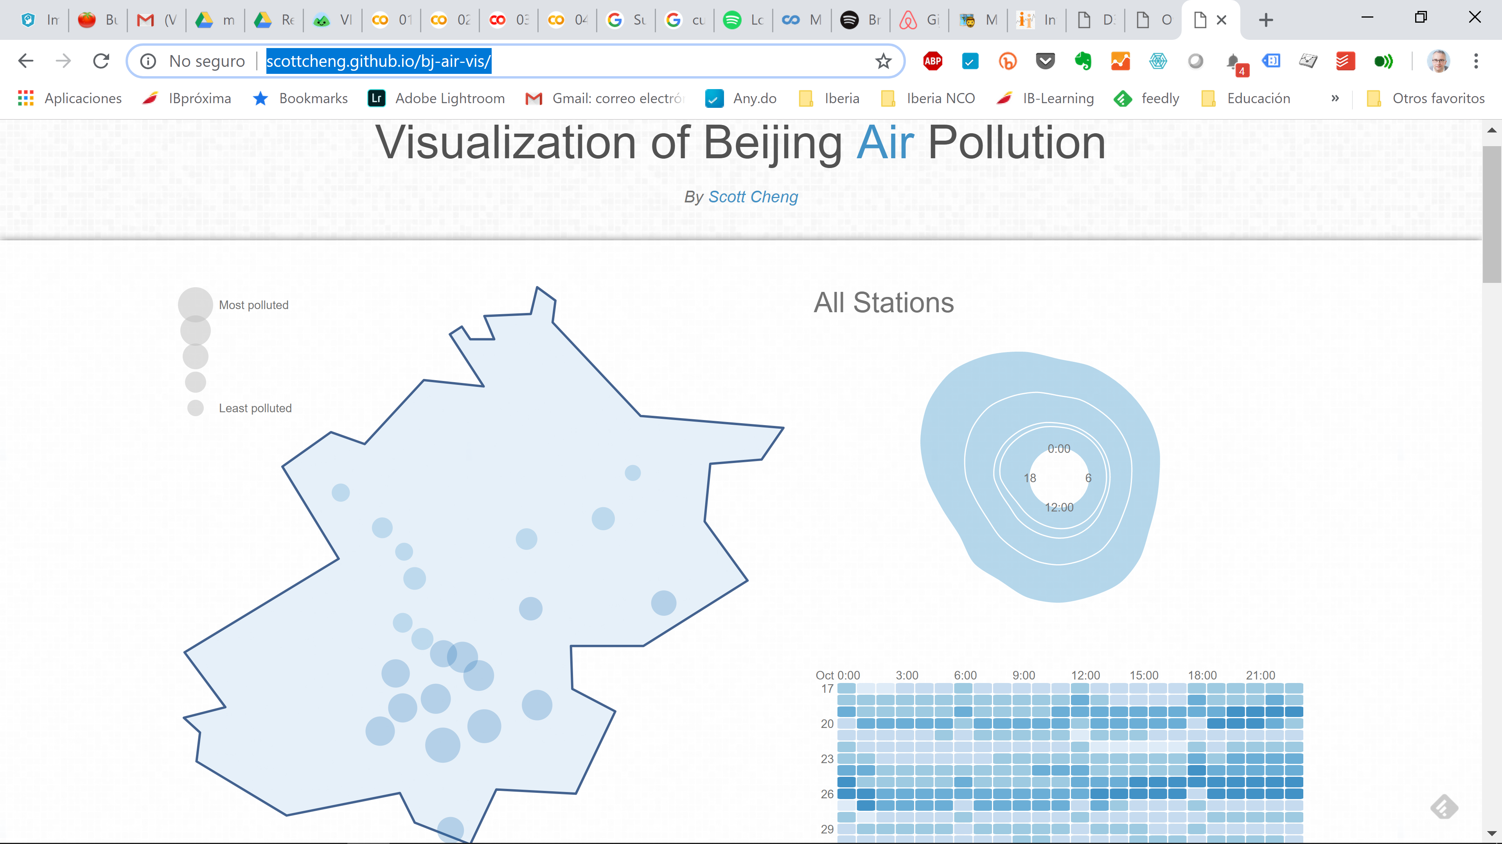

Slide 11






























Slide 12
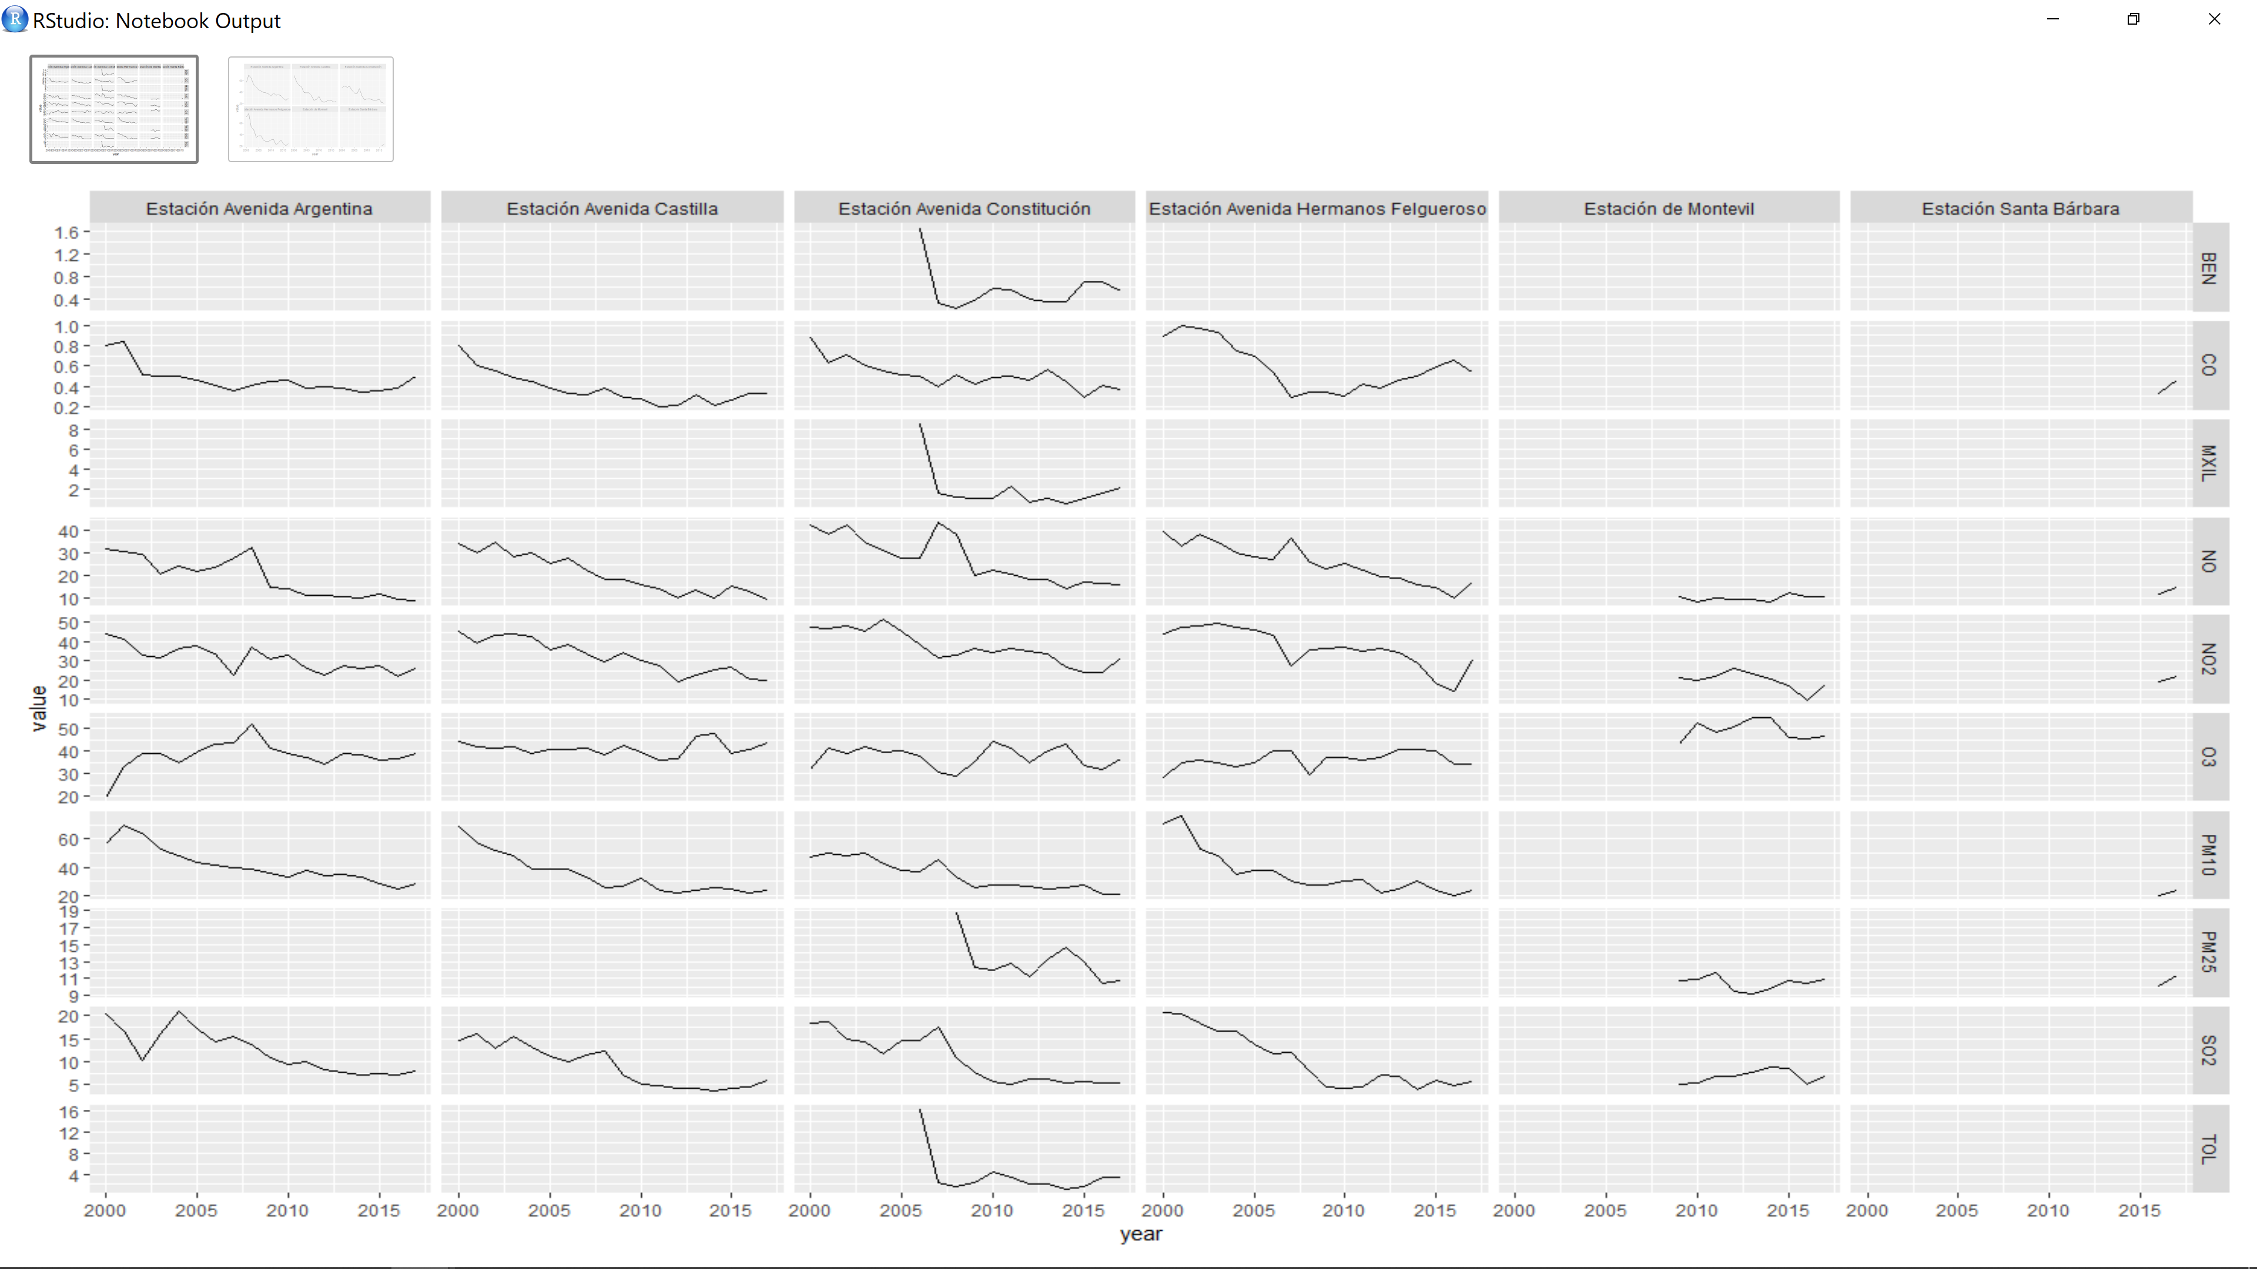





Slide 13
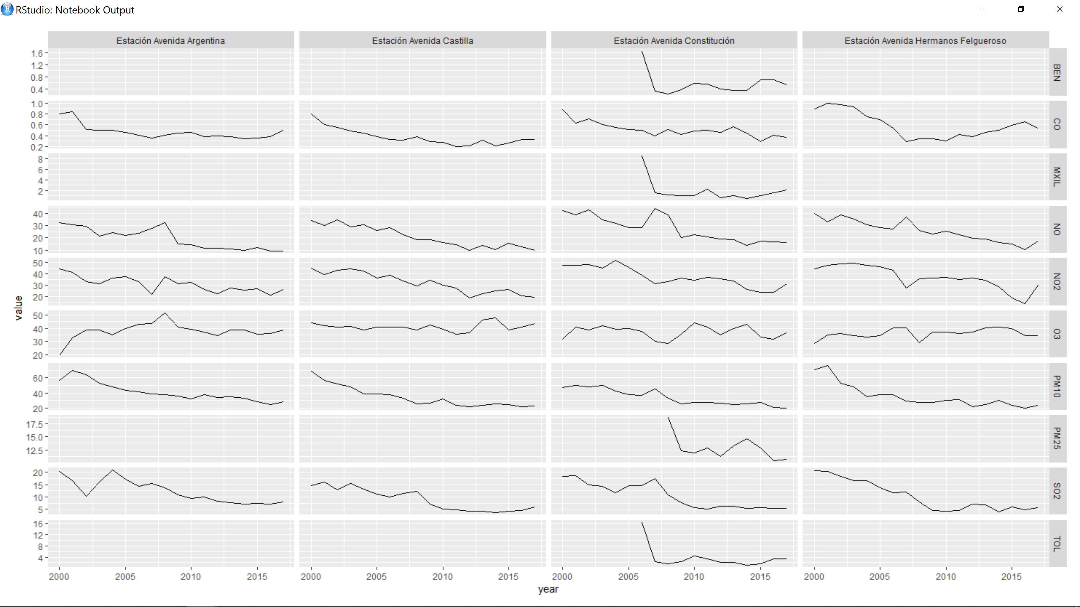











Slide 14
De aquí podría escrapear los datos de las últimas horas?
https://tematico.asturias.es/cecomaweb/estaciones.php?estaciReg=16
Arima python
https://machinelearningmastery.com/arima-for-time-series-forecasting-with-python/
Esto igual me sirve para comparer estaciones
https://campus.datacamp.com/courses/unsupervised-learning-in-python/clustering-for-dataset-exploration?ex=12

Slide 15
airegijon@gmail.com / cono2pm10

